Slide 1
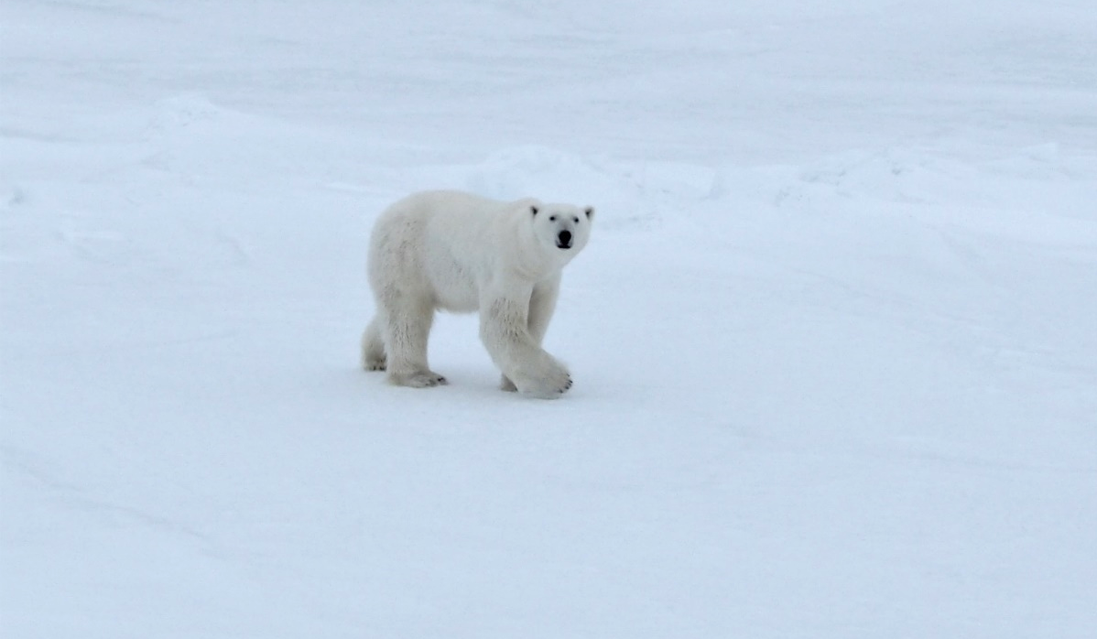
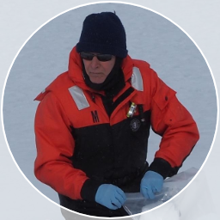

The role of sea ice in mercury cycling and air-sea exchange in the Arctic Ocean in late spring
Robert P Mason, Hannah Inman and Yipeng He
Department of Marine Sciences, University of Connecticut
Marissa Despins, Wright State University
Many thanks to NSF for funding and
and to collaborators on the cruise
AGU Fall Meeting, December 16, 2021

Slide 2
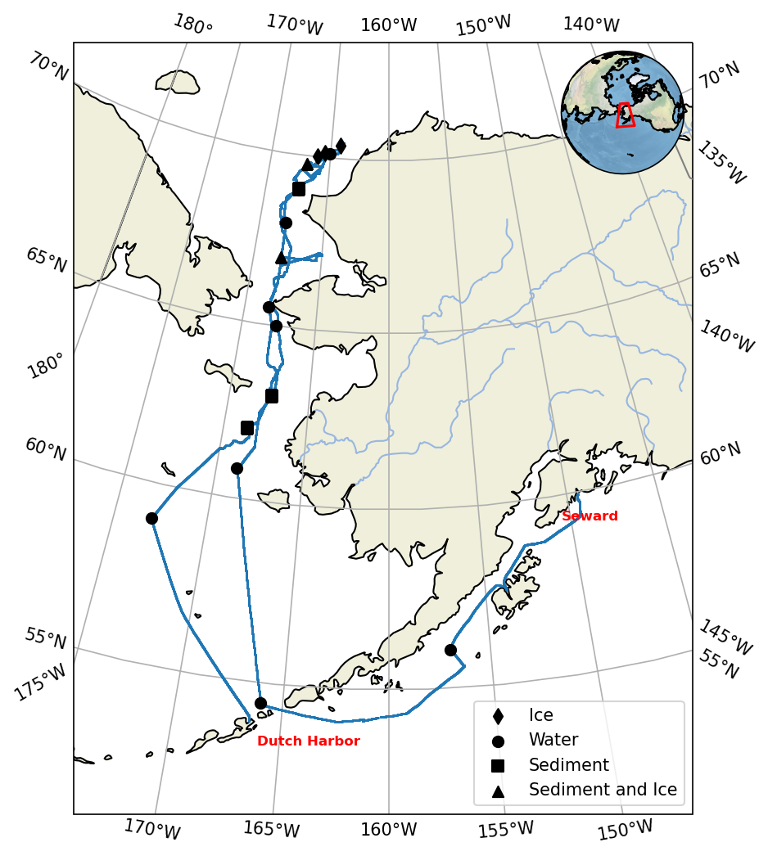
May-June 2021
R/V Sikuliaq
18 stations
Collaborators
Radiotraces - Dave Kadko, Mark Stephens & Doug Hammond
Ar/O₂/productivity – Laurie Juranek
Carbon – Penny Vlahos, Lauren Barret & Emma Shipley
Phys. Oceanog. – Bob Pickart

Slide 3
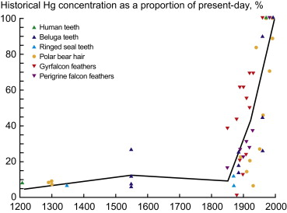
Percent change in the concentrations of mercury in feathers and teeth of Arctic organisms over time
Kirk et al. (2012)

Slide 4
Climate Change Impacts for Mercury
AMAP (2021)

Slide 5
Dastoor et al. (2021)

Slide 6
Dastoor et al., 2021
1. AO is a source of Hg to other oceans
2. Deposition is greater than evasion.
3. Terrestrial inputs are similar to atmospheric inputs
4. Deep ocean sedimentation is a small sink
5. Current budget suggests a net input but this difference is within the uncertainty of the estimates

Slide 7
Daily average atmospheric Hg⁰ (blue) (ng/m³), particulate (PHg, green), and gaseous Hg^{II} (RGHg, magenta) (both pg/m³) at Alert (Nunavut), Canada from 2002 to 2011. From Steffen et al. (2015).
Coastal and island observed Hg depletion events and corresponding high oxidized Hg tend to be most pronounced in the March-June period of the year

Slide 8
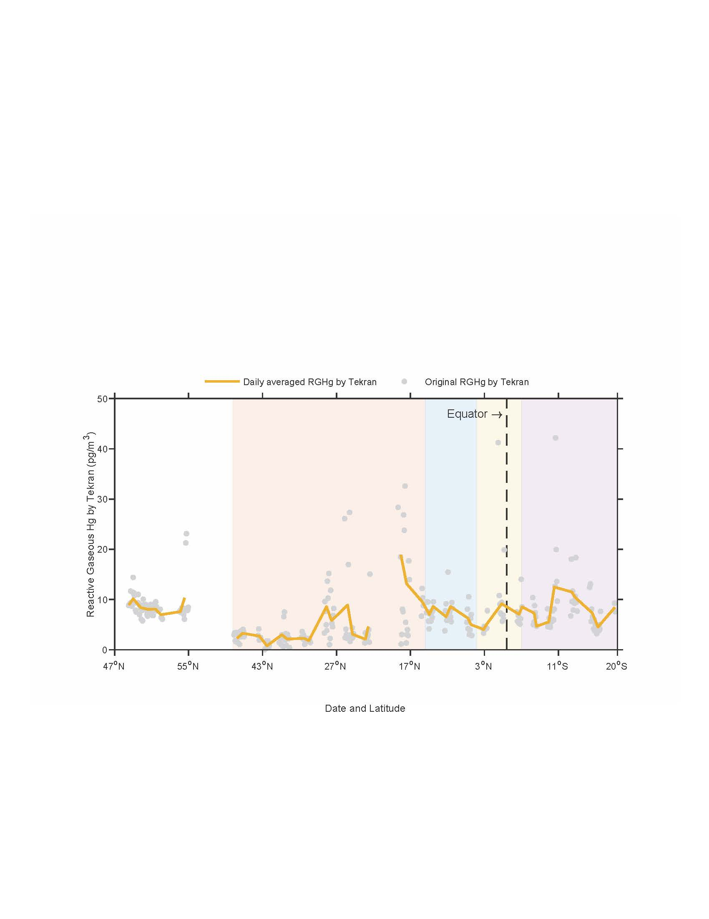
Fall 2015
US Arctic
GEOTRACES
RGHg and HgP <10 pg/m³
DiMento et al. (2019)
Fall 2018
US GEOTRACES
GP15
This is confirmed by available ocean data
He and Mason (2021)

Slide 9
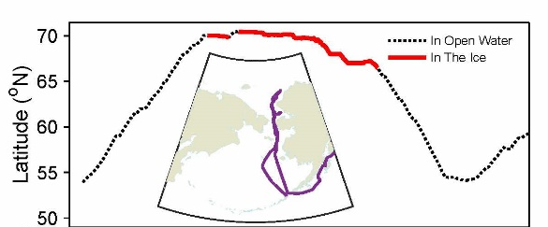
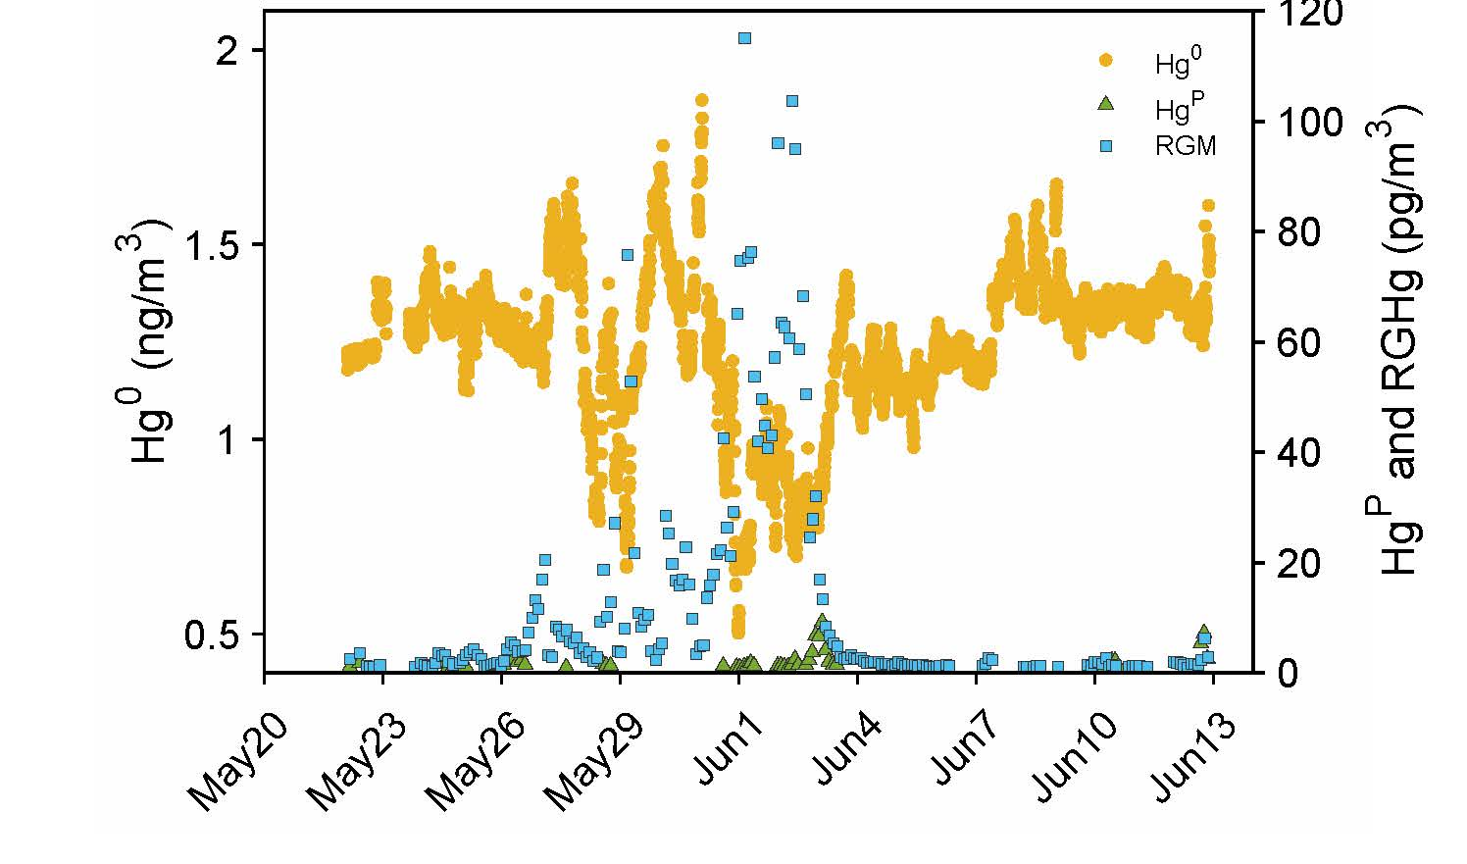
Atmospheric Hg⁰ (yellow) (ng/m³), particulate (HgP, diamond), and gaseous Hg^{II} (RGHg, square) (both pg/m³) during the recent cruise

Slide 10
Gaseous Hg buildup under Ice?
Surface water Hg(0) concentrations (ng L⁻¹) in the Arctic Ocean during a summer (left; Andersson et al., 2008) and fall (right; DiMento et al., 2019) cruise. Grey areas indicate ice-covered water. The area indicated with a punctuated line represents the outflow region from the Mackenzie River Basin.
Dastoor et al. (2021)
The dissolved Hg⁰ (Hg⁰_{diss}) along the U.S. Arctic GEOTRACES cruise into the marginal (light blue shading; 73.5-81°N, 79-77.5°N) and contiguous ice (light red shading; 81-90-79°N) zones.

Slide 11

Underway Hg(0) during May/June 2021 on the Sikuliaq – cruise track left. For comparison, 0.02 ng/L = 100 pmol/m³. Concs lower than found previously under ice

Slide 12
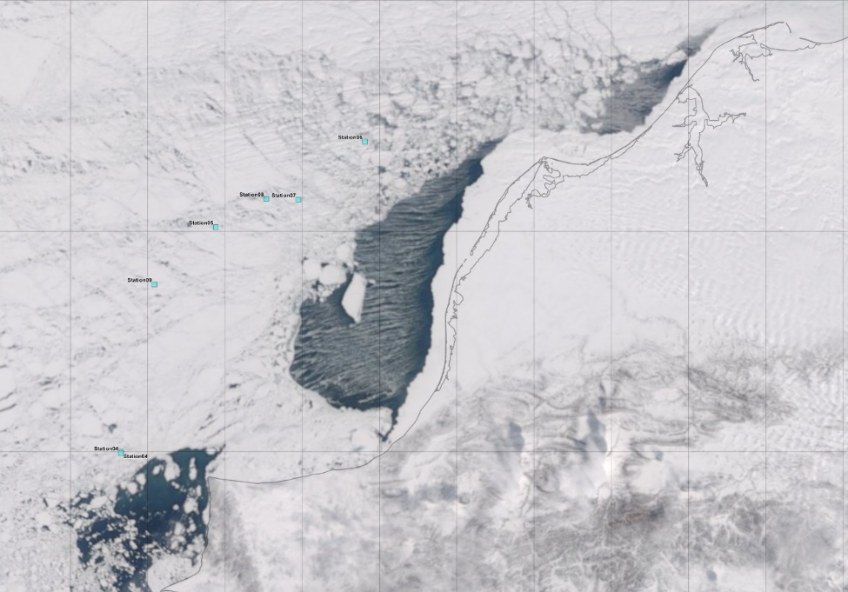
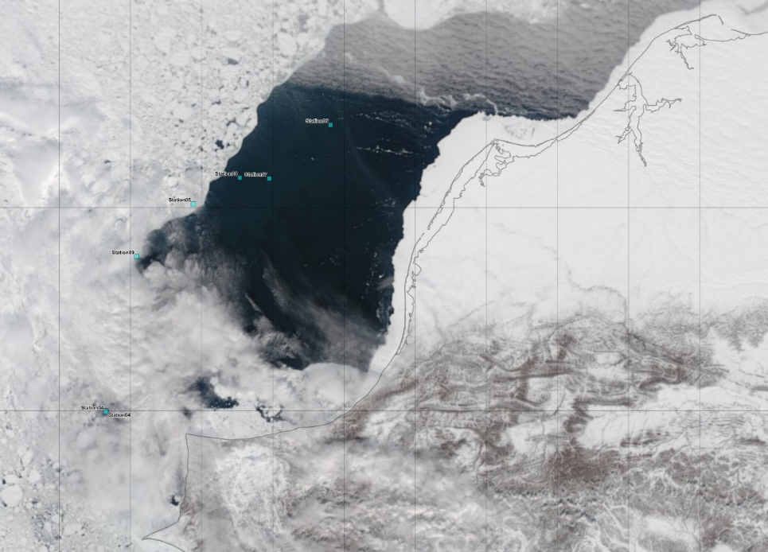
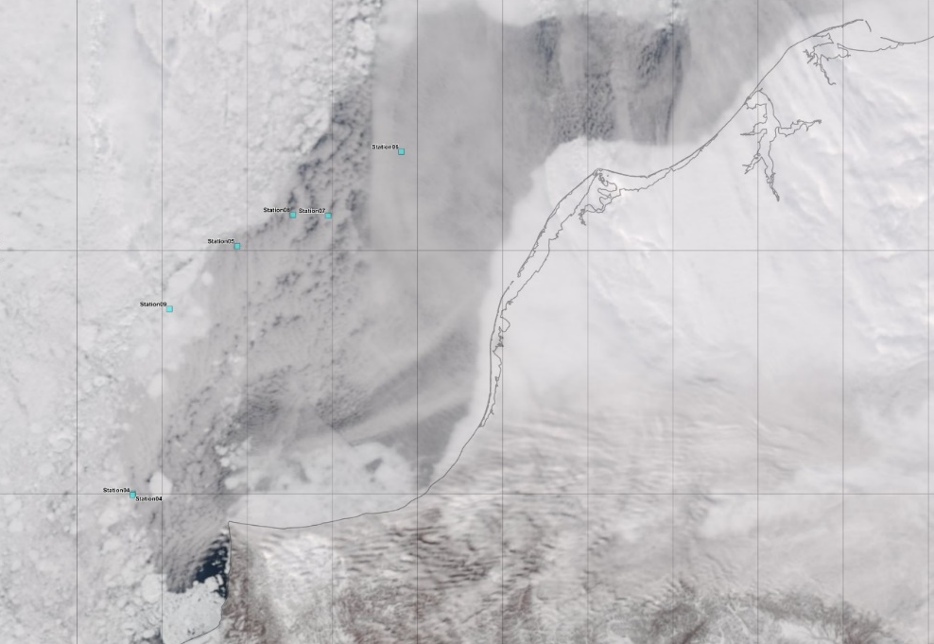
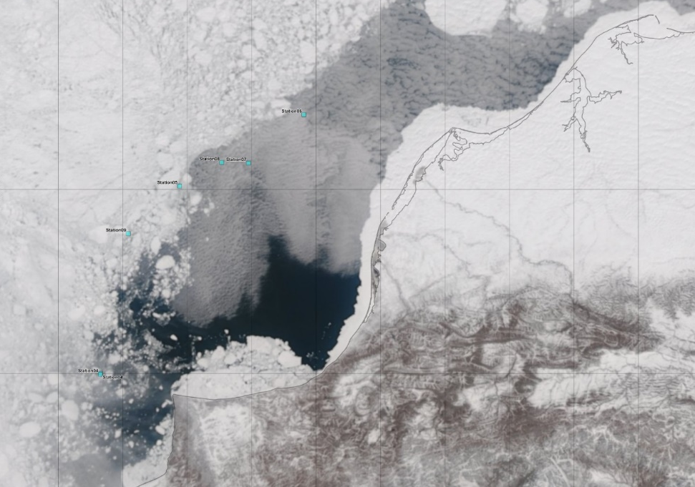
Why are concentrations low under ice? Need to consider the water mass and ice history. Some “ice” stations had open water before our sampling
6
6
8
7
5
8
7
5
9
9
4,10
0512-2156
0513-2228
6
6
5
8
7
5
8
7
9
9
0515-2333
0520-2105

Slide 13
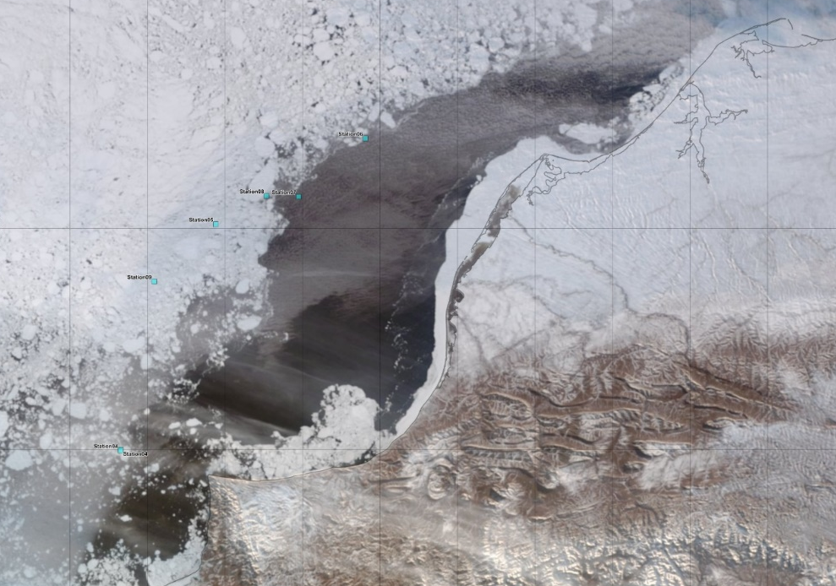
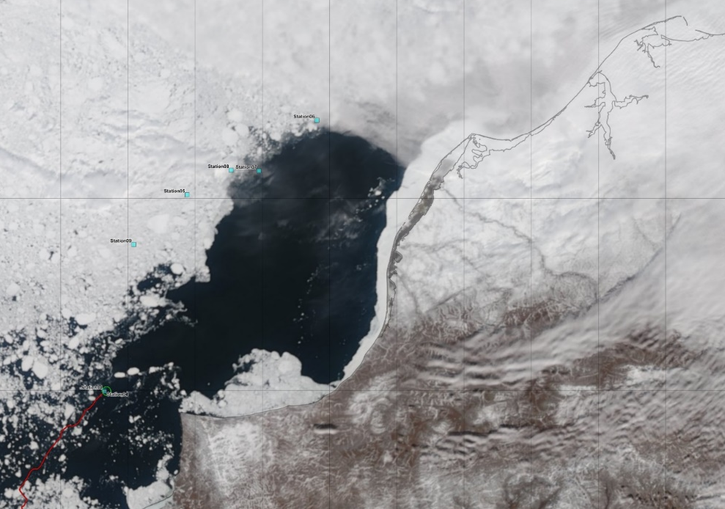
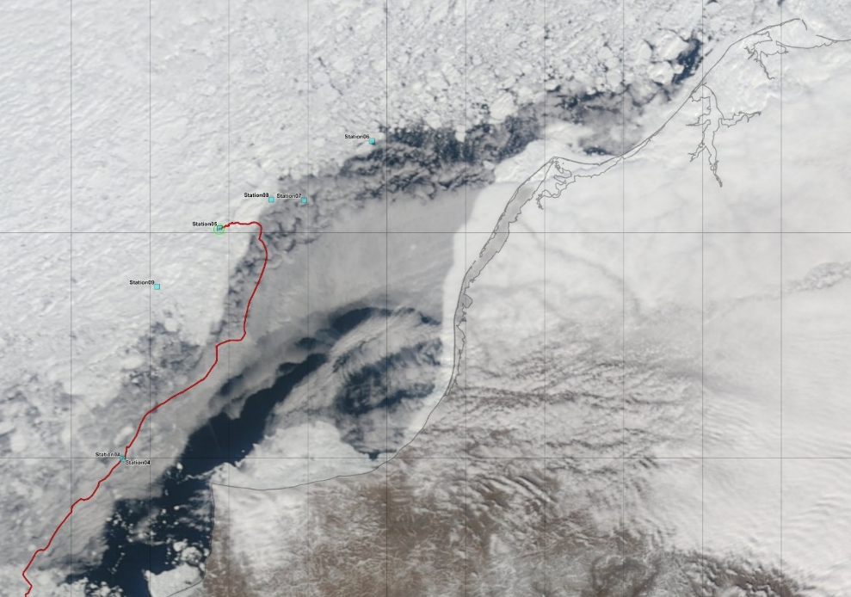
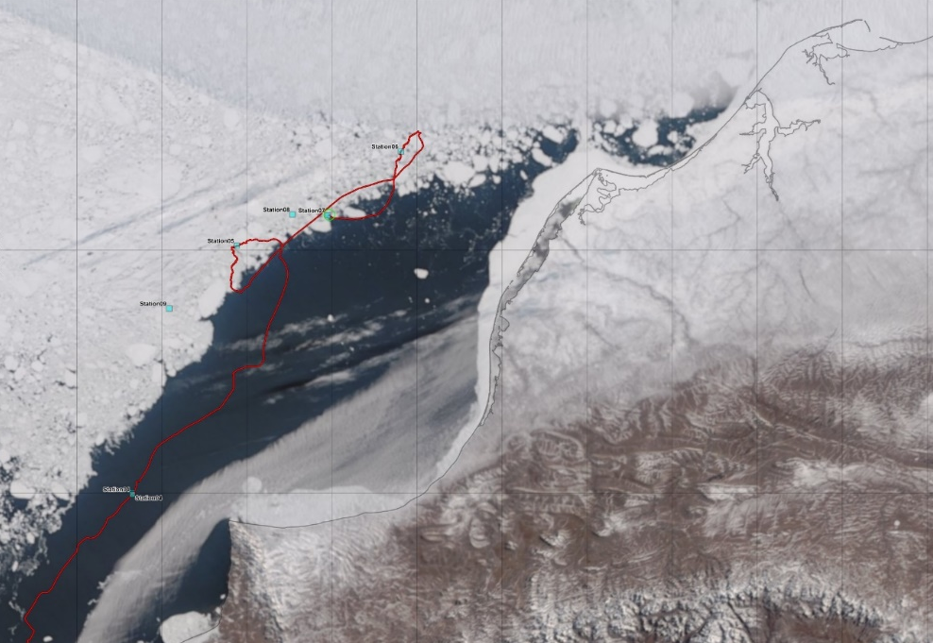
6
6
5
8
7
8
7
5
9
9
0525-1348
0526-2144
Rn-222 and Ra-226 measurements at Stations 6, 8 & 9 indicate that the mixed layer Rn is below secular equilibrium suggesting lack of ice cover and/or water movement from open water to under the ice prior to sampling. Thus, the lack of elevated Hg⁰ may be because of these factors
6
6
5
8
7
5
8
7
9
9
0527-2147
0530-1535

Slide 14
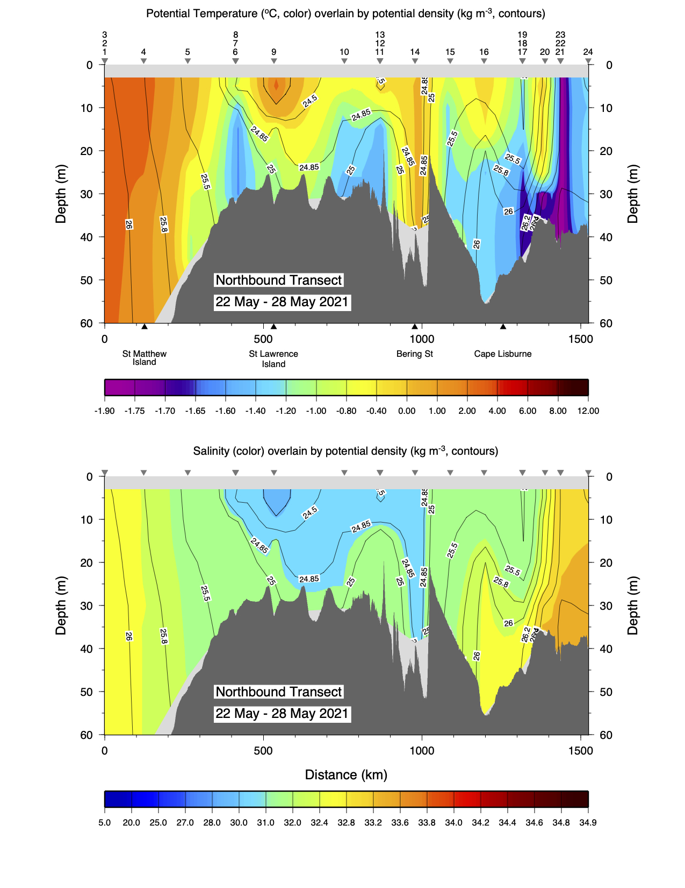
Water column not strongly stratified and little oxygen depletion at the higher latitude stations during the cruise

Slide 15
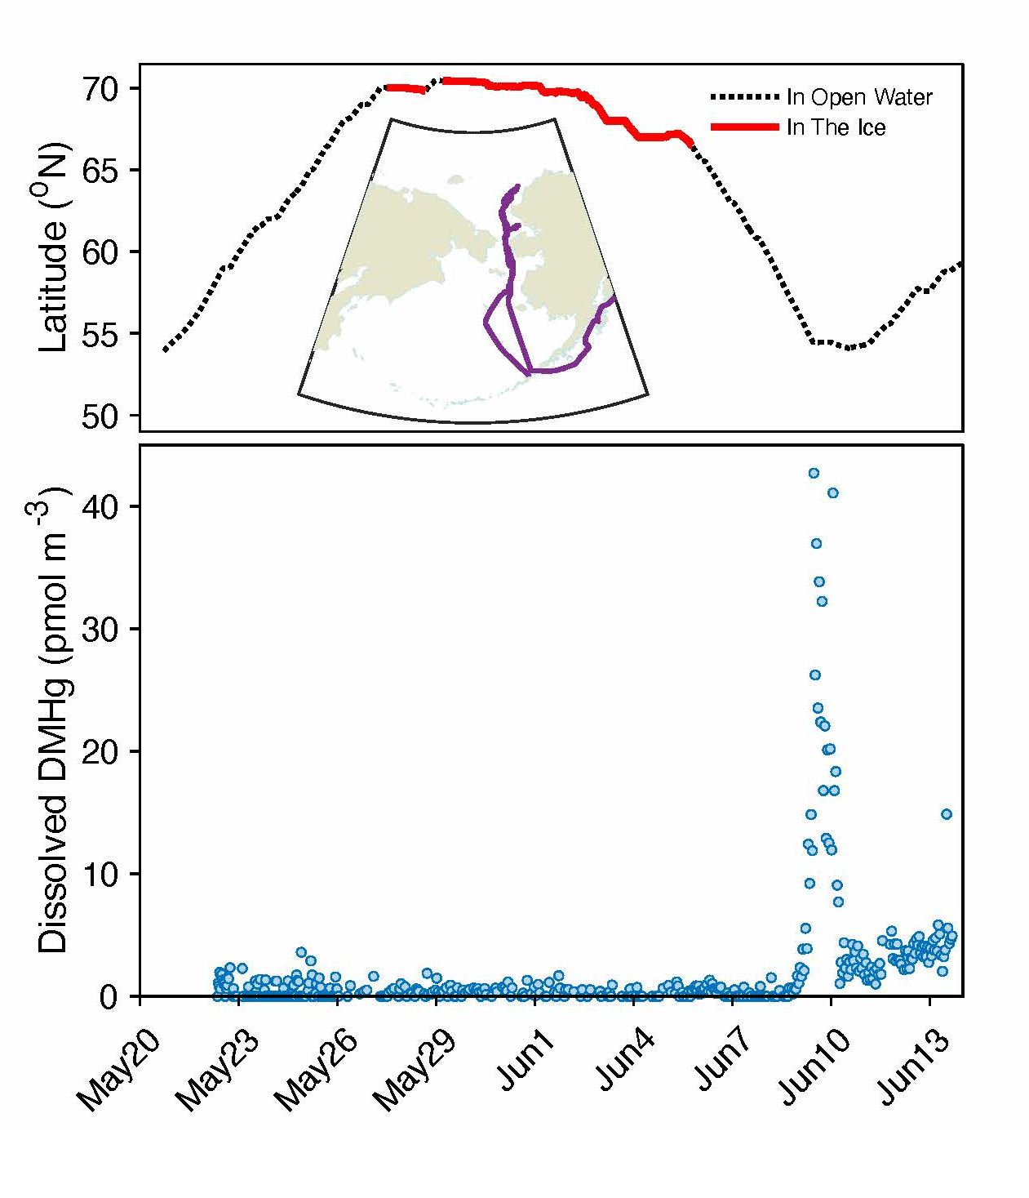
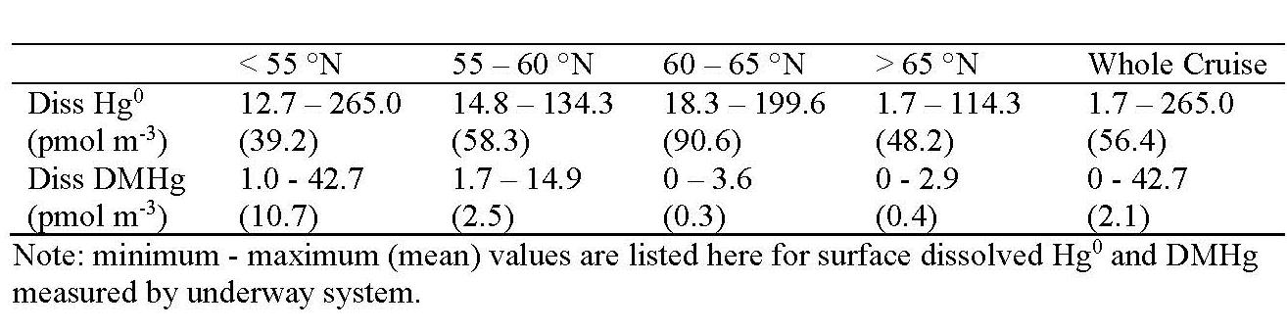
Underway measurements of DMeHg. Low in the ice region and generally low (<5 fM) except for the region close to the Aleutians where high DMeHg and MeHg was also found throughout the water column

Slide 16
St. 7
St. 6
St. 5
St. 4
Increasing MeHg as moved north and under ice, but highest concentrations are not near surface but at mid-depth. Measurable DMeHg at all stations but <10 fM, and lowest at 10 m (<5 fM)
Underway Hg⁰ <100 fM for these stations, so its higher in the deeper waters than under the ice/in the mixed layer

Slide 17
Vertical profiles of elemental and methylmercury measured on the US Geotraces cruise show that their distri-butions are comparable with our data
Low MeHg for surface waters, especially on the shelf of the Chukchi Sea
AMAP (2021)
Agather et al., (2019)

Slide 18
Conclusions
Yearly sea ice enhances the oxidation of Hg⁰ to oxidized gaseous and particulate Hg and the extent of formation in the absence of sea ice was small during the cruise;
Levels of Hg⁰ under regions of current/recent seasonal ice are not elevated as predicted based on previous cruises suggesting either that accumulation of Hg⁰ under ice is a long-term process or that loss of ice cover, water mass flow and other physical factors had resulted in Hg⁰ loss prior to sampling. Further analysis is needed to resolve this, which is important for constraining the annual evasion flux from Arctic waters;
While DMeHg was measurable in the mixed layer, its low concentrations suggest that its evasion is not an important source of atmospheric MeHg at this time of year. There was also no DMeHg detected in the ice cores collected on this cruise; and
Further data analysis is needed to understand the net exchange of Hg at the air-sea interface during the Arctic spring.

Slide 19
References
AMAP (2021). Arctic Monitoring and Assessment Program Mercury Assessment: Summary for policy makers. https://www.amap.no/documents/doc/2021-amap-mercury-assessment.-summary-for-policy-makers/3510
Andersson et al. (2008) . Enhanced concentrations of dissolved gaseous mercury in the surface waters of the Arctic Ocean. Mar. Chem. 110, 190-194
Agather et al. (2019) Distribution of mercury species in the Western Arctic Ocean (U.S. GEOTRACES GN01). Mar. Chem. 216, 103686.
Dastoor et al. (2021) Arctic mercury cycling. Accepted for publication in Nature Reviews: Earth and Environment, 11/21.
DiMento et al. (2019) The impact of sea ice on the air-sea exchange of mercury in the Arctic Ocean. Deep Sea Res. I 144, 28-38.
He and Mason (2021) Comparison of reactive gaseous mercury measured by KCl-coated denuders and cation exchange membranes during the Pacific GEOTRACES GP15 expedition. Atmos. Environ. 244, 117973.
Kirk et al. (2012) Mercury in Arctic marine ecosystems: sources, pathways and exposure. Environ. Res. 119, 64–87.
Steffen et al. (2015) Atmospheric mercury in the Canadian Arctic. Part I: a review of recent field measurements. Sci. Total Environ. 509–510, 3–15.

Slide 20
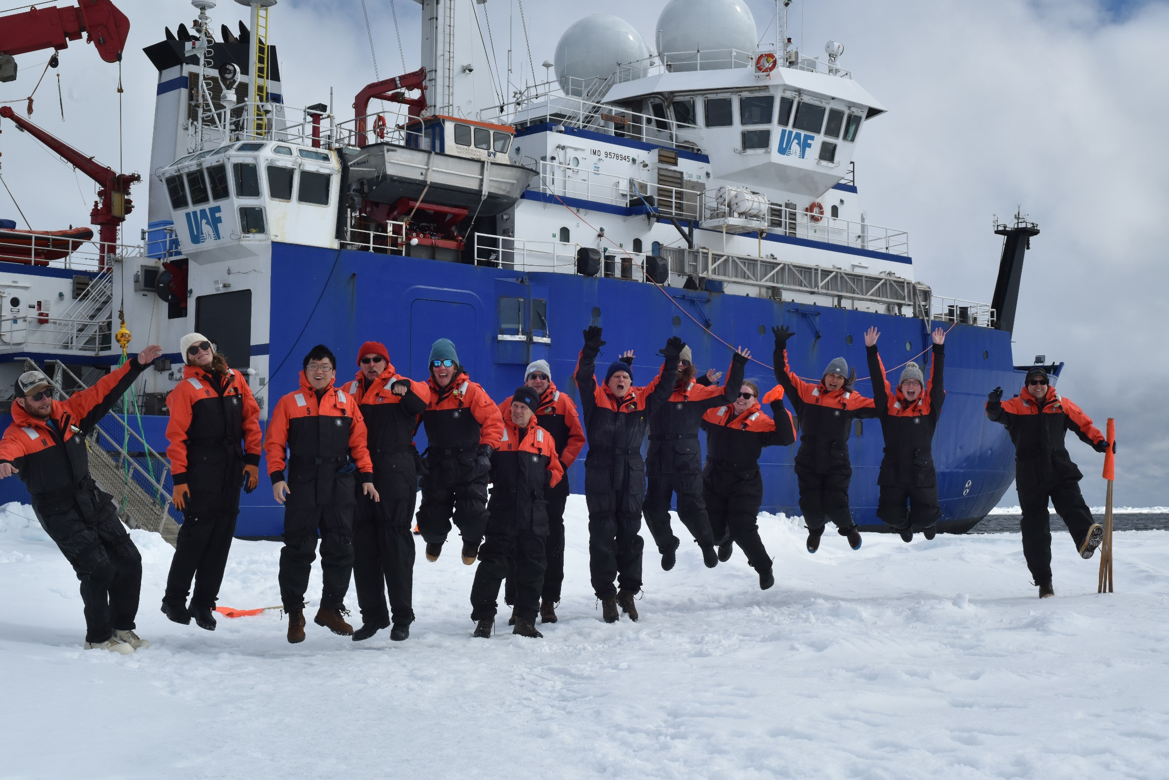
Any Questions?
The scientists (mercury and other researchers, and research techs) from the Siluliaq spring 2021 expedition

